Slide 1
Device Management

Slide 2
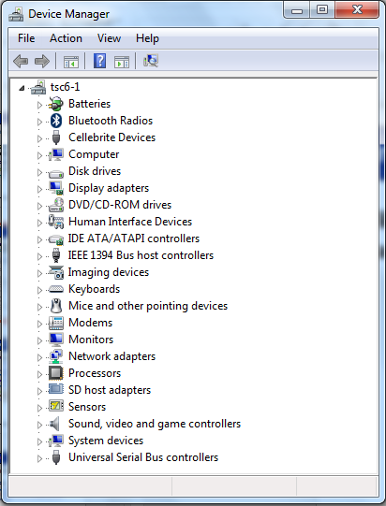
Device Management
One of the main functions of an operating system is to control and manage all the devices connected to the computer system.

Slide 3
Device Management Functions
Device management involves four functions:
Monitoring the status of each device
Allocating the devices
Deallocating the devices
Enforcing preset policies to determine which process will get a device and for how long
The above are what the Device Manager do …

Slide 4
Device Manager
For device manager to perform its assigned tasks, it must be able to :
Control each device’s workings
Track its free/busy status
Know how to accommodate access requests that arrive when the device is busy
Handle the difference in transmission speeds when some devices are slower or faster than other parts of the computer system e.g. between CPU and I/O devices

Slide 5
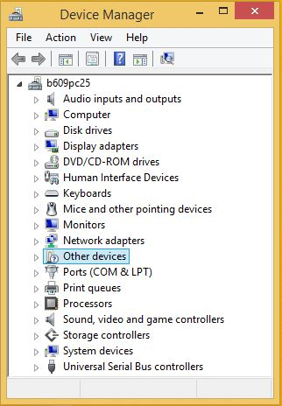
On the computer system, open Device Manager.
The interface to the Device Manager is a Control Panel applet in Microsoft Windows operating systems. It allows users to view and control the hardware attached to the computer.
For each device, users can:
Update device drivers
Enable or disable devices
Tell Windows to ignore malfunctioning devices
View other technical properties

Slide 6
(i) Explore the Device Manager applet in your own computer and identify the various hardware devices on the computer system.
Item | Actual Hardware Device
CPU or Processor
Storage devices
Input devices
Output devices

Slide 7
(ii) On the same applet in your own computer, determine the video card (controller) for the monitor. What category is this device belong to? Explain your answer.
Item | Actual Hardware Device
Video Card/Graphic Controller

Slide 8
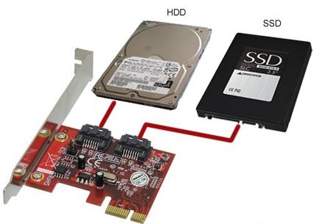
I/O Unit
An I/O unit typically consists of :
an electronic component called the device controller (or adapter), and
the device itself
On personal computers, it often takes the form of a printed circuit card that can be inserted into an expansion slot.

Slide 9
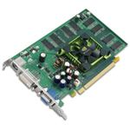
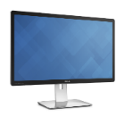
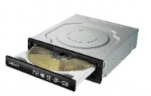
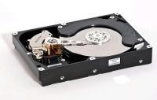
I/O Unit
Operating System
Operating System kernel
Software
Generic Monitor driver
Generic Disk driver
Monitor device driver
Hard disk device driver
DVD/CDROM device driver
Hardware
I/O Unit
Hard disk Controller
Video card
DVD/CDROM Controller
Monitor
Disk Drive
DVD/CDROM drive

Slide 10
Device Drivers
A device driver translates computer code to display text on a screen, or translates movements of a mouse into action.
A separate device driver is usually installed for each I/O device.
The device driver contains the actual programming code (instructions) required to control/manipulate the specific device.
This way, if another piece of hardware is introduced into the computer, the OS code does not have to change.
The computer just need to load a new device driver onto the OS.

Slide 11
Device Drivers
The OS communicates with devices via the device drivers.
A device driver is a program that controls a particular type of device that is attached to your computer e.g. device driver for monitor, mouse, etc.
A device driver translates computer code to display text on a monitor screen, or translates movements of a mouse into action.

Slide 12
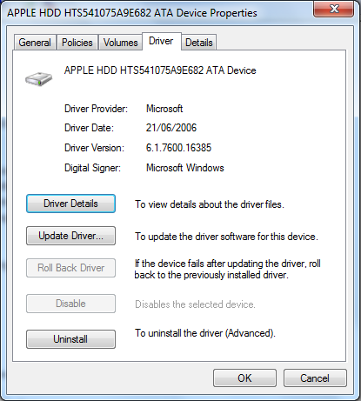
Device Drivers
On Windows computers, you can check the status of a device driver of a device from the list in the Device Manager from Control Panel:
Control Panel → Device Manager and select the device
Notes:
Microsoft offers manufacturers a path for having their drivers “signed” (look at Digital Signer in the screen capture).
If you try to install an unsigned driver, you will get warning that you are about to install an unsigned driver.
You are encouraged not to install unsigned drivers because they may harm your computer.

Slide 13
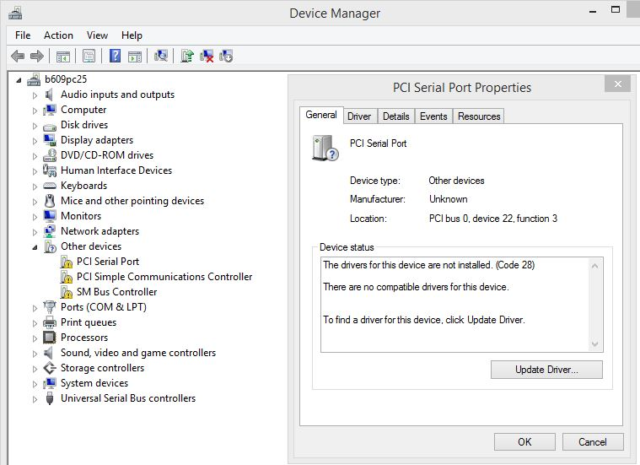
Tutorial Question 2.2
Device Drivers
When a hardware device is attached (or installed) on a computer and it doesn't work properly. The device will appear on the Device Manager applet with an exclamation mark on it as shown in the screen capture below.
Explain what actions you would take to set up the device successfully.
Enter your solution on the spreadsheet given in Week 2 channel.
Notes:
Possible actions:
Run the installation software which had probably been supplied with the device on a CD-ROM, which contains the driver. Many devices require special drivers to work properly. Be sure that you have installed any software discs that came with the device.
Make sure that the hardware device is compatible with your computer and with your version of Windows. If the device isn't compatible, you will need to find the correct driver. Direct the installation to a known location where the compatible device driver can be found.
Restart the computer. Restarting might be necessary if the driver requires it, or if the driver didn't install correctly.
If the device is a universal serial bus (USB) device, disconnect it and then plug it in to a different USB port. Windows should detect the device and install the drivers, and notify you if the device drivers didn't install properly.
Updated drivers might be available through Windows Update. When you check Windows Update, click View available updates to determine if an updated driver is available for your device.

Slide 14
End
Device Drivers – Thinking Question
Notes:
Possible actions:
Run the installation software which had probably been supplied with the device on a CD-ROM, which contains the driver. Many devices require special drivers to work properly. Be sure that you have installed any software discs that came with the device.
Make sure that the hardware device is compatible with your computer and with your version of Windows. If the device isn't compatible, you will need to find the correct driver. Direct the installation to a known location where the compatible device driver can be found.
Restart the computer. Restarting might be necessary if the driver requires it, or if the driver didn't install correctly.
If the device is a universal serial bus (USB) device, disconnect it and then plug it in to a different USB port. Windows should detect the device and install the drivers, and notify you if the device drivers didn't install properly.
Updated drivers might be available through Windows Update. When you check Windows Update, click View available updates to determine if an updated driver is available for your device.

